Slide 1
Introduction To Web Development
By- Shreshth Tiwari B.Tech CSE Section - B Roll No - 32

Slide 2
Web Development
Web development is the building and maintenance of websites; it’s the work that happens behind the scenes to make a website look great, work fast and perform well with a seamless user experience.
Web developers, or ‘devs’, do this by using a variety of coding languages. The languages they use depends on the types of tasks they are preforming and the platforms on which they are working.
Web development skills are in high demand worldwide and well paid too – making development a great career option. It is one of the easiest accessible higher paid fields as you do not need a traditional university degree to become qualified.
The field of web development is generally broken down into front-end (the user-facing side) and back-end (the server side).

Slide 3
Front End
A front-end dev takes care of layout, design and interactivity using HTML, CSS and JavaScript. They take an idea from the drawing board and turn it into reality.
What you see and what you use, such as the visual aspect of the website, the drop down menus and the text, are all brought together by the front-end dev, who writes a series of programmes to bind and structure the elements, make them look good and add interactivity. These programmes are run through a browser.

Slide 4
Back End
The backend developer engineers what is going on behind the scenes. This is where the data is stored, and without this data, there would be no frontend. The backend of the web consists of the server that hosts the website, an application for running it and a database to contain the data.
The backend dev uses computer programmes to ensure that the server, the application and the database run smoothly together. This type of dev need to analyse what a company’s needs are and provide efficient programming solutions. To do all this amazing stuff they use a variety of server-side languages, like PHP, Ruby, Python and Java.

Slide 5
Front End
HTML
CSS
JS

Slide 6
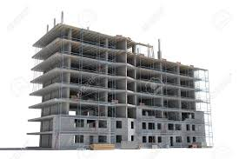
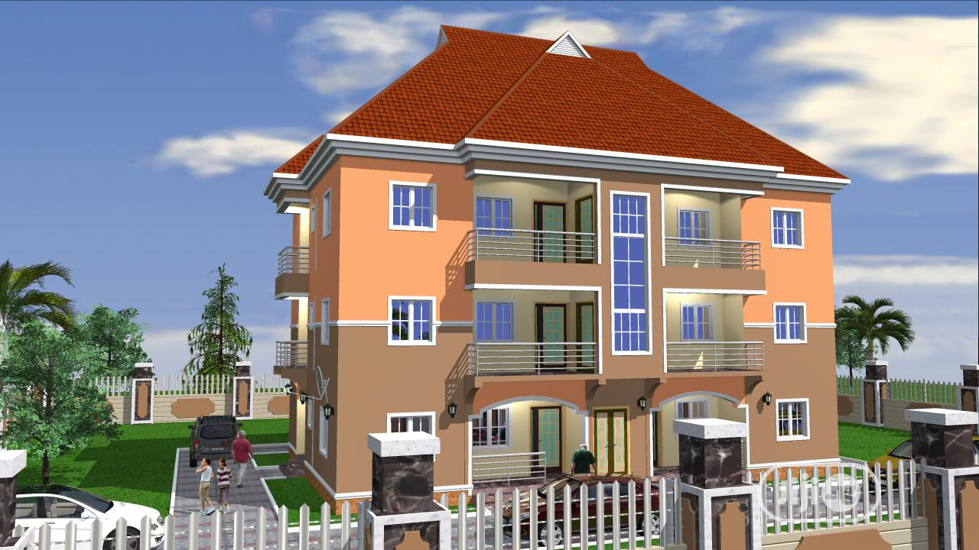
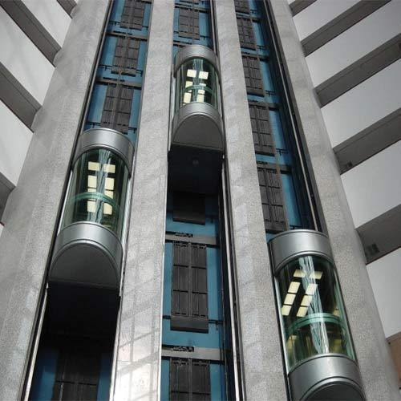
3 Layers Of Web Design
Structure Style Behaviour
HTML markup CSS JavaScript

Slide 7
HTML Hyper Text Markup Language

Slide 8
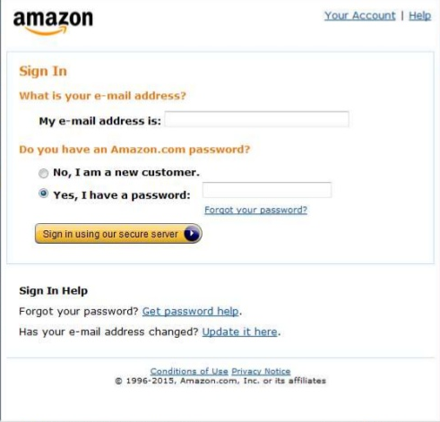
HTML
Can you imagine how this page will look like without HTML?

Slide 9
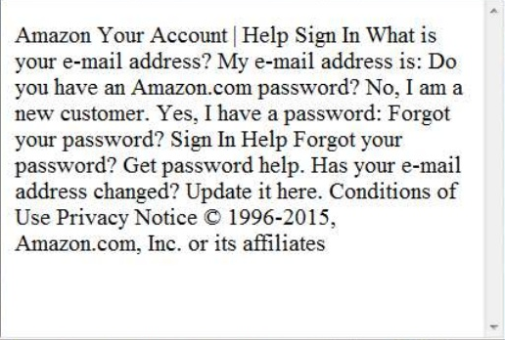
HTML
Looks ungly.....
isn't it?

Slide 10
No HTML
Without any markup to give to your page content structure, the browser renderes unformatted and unstyled text.

Slide 11
HTML Tags
HTML Tags give structure and meaning to your content.

Slide 12
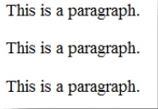
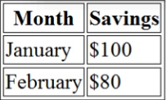
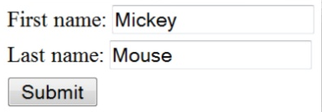

HTML Tags
<p> </p> - To organize text into pragraphs.
<table> <table> - To display tables.
<form> </form> - To define form for user input.
<img> </img> - To add image.

Slide 13
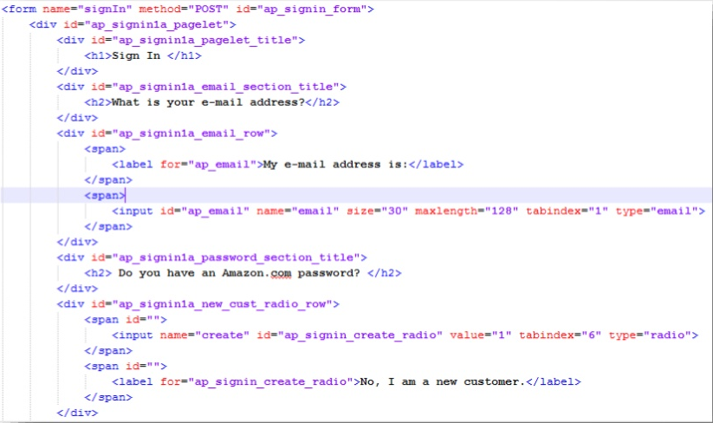
HTML
How Will It Look Now?

Slide 14
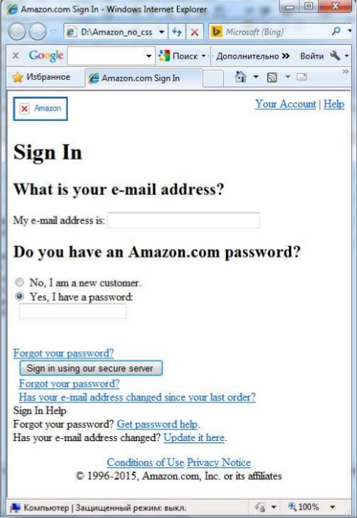
HTML
Looks better... But still not good...

Slide 15
HTML
Once page content is marked up with HTML tags, the browser applies default styles to the tags.
So now page is redable and have a clear hierarchy.

Slide 16
CSS !
But what should we do to make it look better?

Slide 17
CSS Cascading Style Sheet

Slide 18
CSS
Set of rules defining how an HTML element will be ”presented” in the browser.

Slide 19
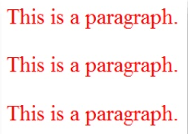
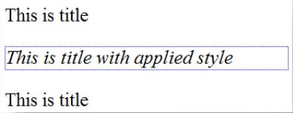
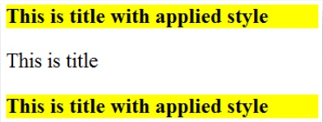
CSS Rules
p {
color:red;
}
#title{
font-style: italic;
border: 1px dotted blue;
}
.title{
font-weight: bold;
background: yellow;
}

Slide 20
Things you can chnage with CSS
colors
font
font size
backgrounds
spacing
size
border
positions (layout)

Slide 21
Things you can't chnage with CSS
content
markup

Slide 22
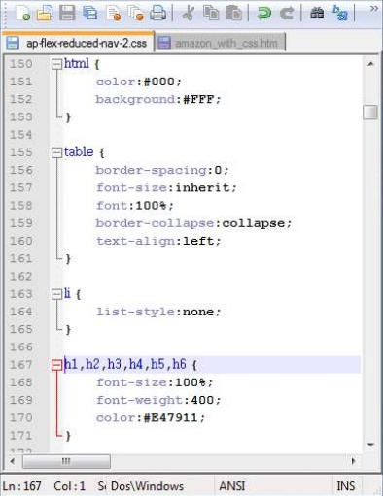
So now it's time for styling!!!
Lets add some CSS rules to to our example page.

Slide 23
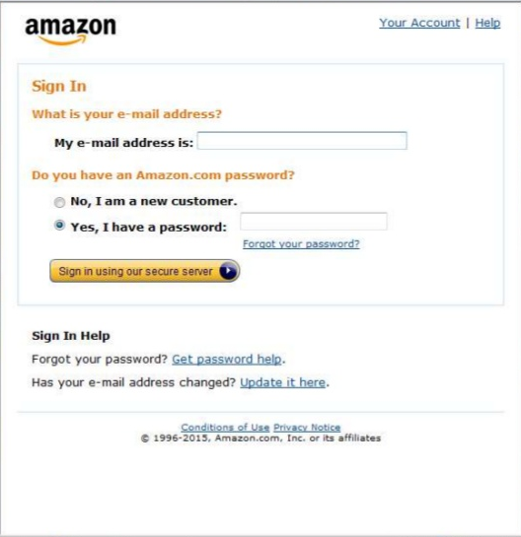
CSS
Looks Perfect !

Slide 24
Text + HTML + CSS = CSS

Slide 25
JavaScript
Now time for actions !

Slide 26
JavaScript ≠ Java
JavaScript was not developed at Sun Microsystems, the home of Java.
JavaScript was developed at Netscape in 1995.
It was originally called LiveScript, but the name wasn't confusing enough.
Java was the buzzword in the days when Livecript was created, so LiveScript was renamed into JavaScript in the jope of catching the media's interest.
But with confusion came misunderstanding...

Slide 27
JavaScript ≠ Java
JavaScript is NOT Java.
It is NOT a light version of Java.
It was NOT based on Java.
It does NOT matter if you know Java.

Slide 28
JavaScript
Classis JavaScript is a client-side language used to add interactivity to your web pages.
Web Browser
Web Page
JavaScript

Slide 29
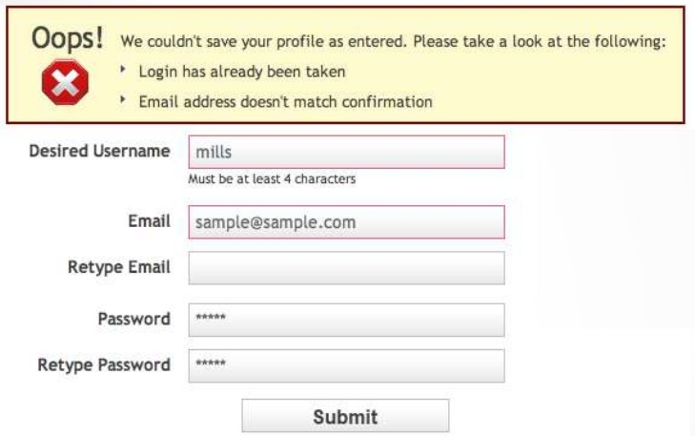
What we can do with JavaScript
Validate values entered in the form fields

Slide 30
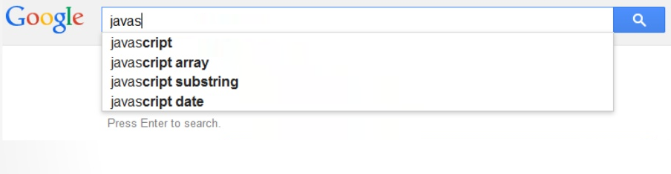
What we can do with JavaScript
A search box can give you search results while you type, based onwhat you've entered.

Slide 31
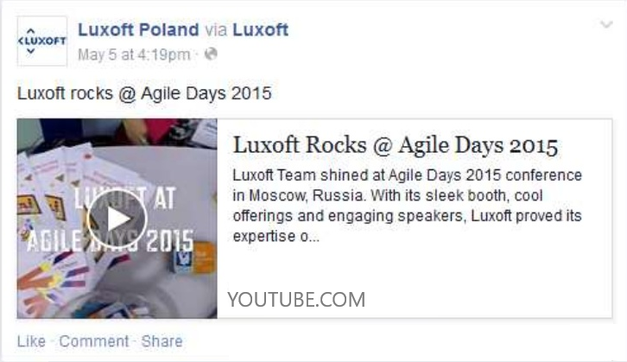
What we can do with JavaScript
Load information automatically when it's needed

Slide 32





What we can do with JavaScript
Create photo slideshow and control how long it takes to move form one image to next and with what animation effect.

Slide 33
What we can do with JavaScript
And Much More...

Slide 34
JavaScript
At the beginning JavaScript was designed to manipulate web pages.
And it does that very well !!!
But nowadays it's usage is much much wider: you can use it outside of web pages and the browser.
And one of the best example of it is: Discord Bot coding !!!

Slide 35
Thank You

